Slide 1
ATAI
Advanced Techniqueof Artificial Intelligence
ATAI
ChongqingUniversity _{AdvancedTechniqueof}
of Technology Artificial Intelligence
Chongqing University of
Technology
Chongqing University ^{ATAI}
_{of Technology} Advanced Techniqueof
Artificial Intelligence
Chongqing University of Technology
Chongqing University of Technology
Correlation-Decoupled Knowledge Distillation for
Multimodal Sentiment Analysis with Incomplete Modalities
Code:None
2024.7.25 •ChongQing
—— CVPR 2024
Reported by YaoChen Li
1

Slide 2
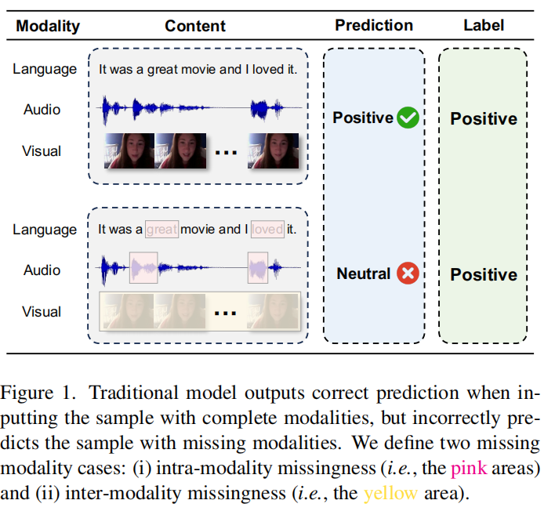
ATAI
AdvancedTechniqueof
Artificial Intelligence
ATAI
ChongqingUniversity _{AdvancedTechniqueof}
of Technology Artificial Intelligence
ChongqingUniversity of Technology
Motivation
(1)In real-world, some practical factors cause uncertain modality missingness, which drastically degrades performence of the model.
(2)Failure to model cross-category correlations leads to loss of sentiment-relevant information and confusing distributions among categories.
(3)Coarse supervision ignores the semantic and distributional alignment.

Slide 3
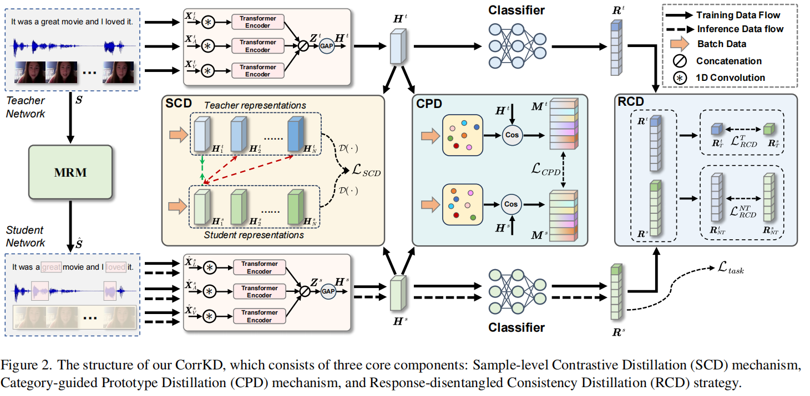
ChongqingUniversity of Technology
ATAI
AdvancedTechniqueof
Artificial Intelligence
ATAI
ChongqingUniversity _{AdvancedTechniqueof}
of Technology Artificial Intelligence
Overview

Slide 4
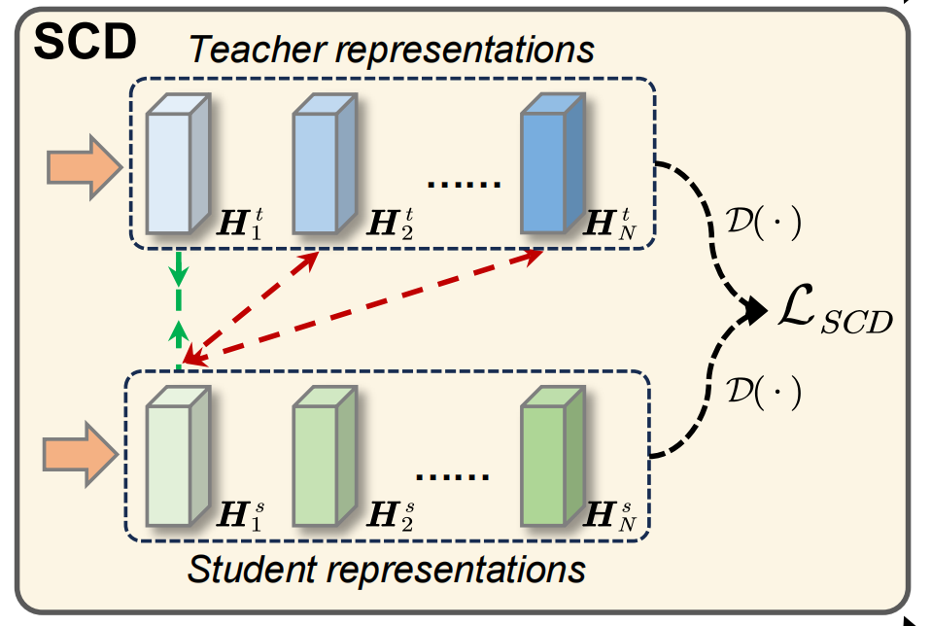
ChongqingUniversity of Technology
ATAI
AdvancedTechniqueof
Artificial Intelligence
ATAI
ChongqingUniversity _{AdvancedTechniqueof}
of Technology Artificial Intelligence
Overview
(1)
(5)
(2)
(3)
(4)

Slide 5
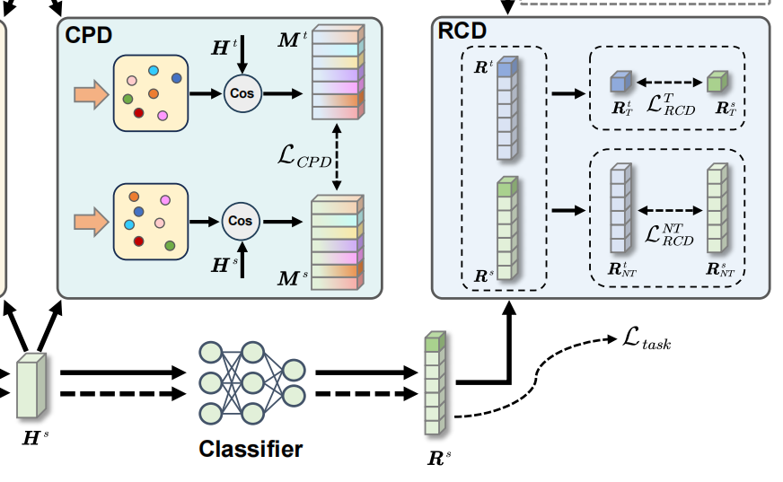
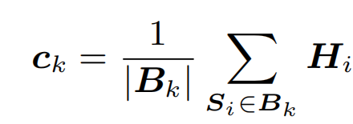
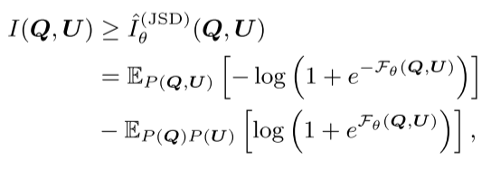
ChongqingUniversity of Technology
ATAI
AdvancedTechniqueof
Artificial Intelligence
ATAI
ChongqingUniversity _{AdvancedTechniqueof}
of Technology Artificial Intelligence
Method
(6)
(7)
(8)
(9)
(11)
(12)
(10)

Slide 6
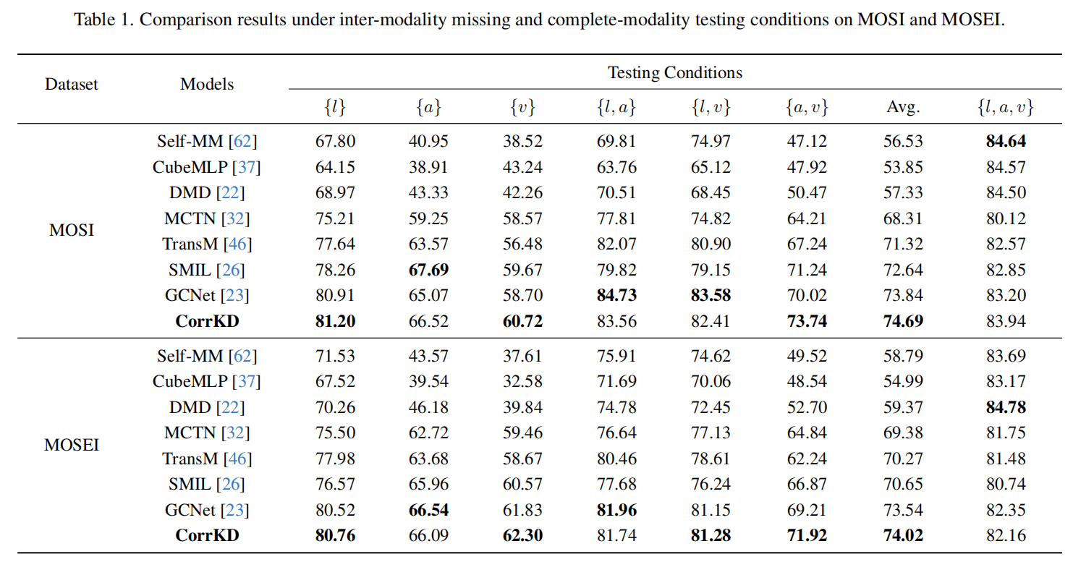
ATAI
AdvancedTechniqueof
Artificial Intelligence
ATAI
ChongqingUniversity _{AdvancedTechniqueof}
of Technology Artificial Intelligence
ChongqingUniversity of Technology
Experiments

Slide 7
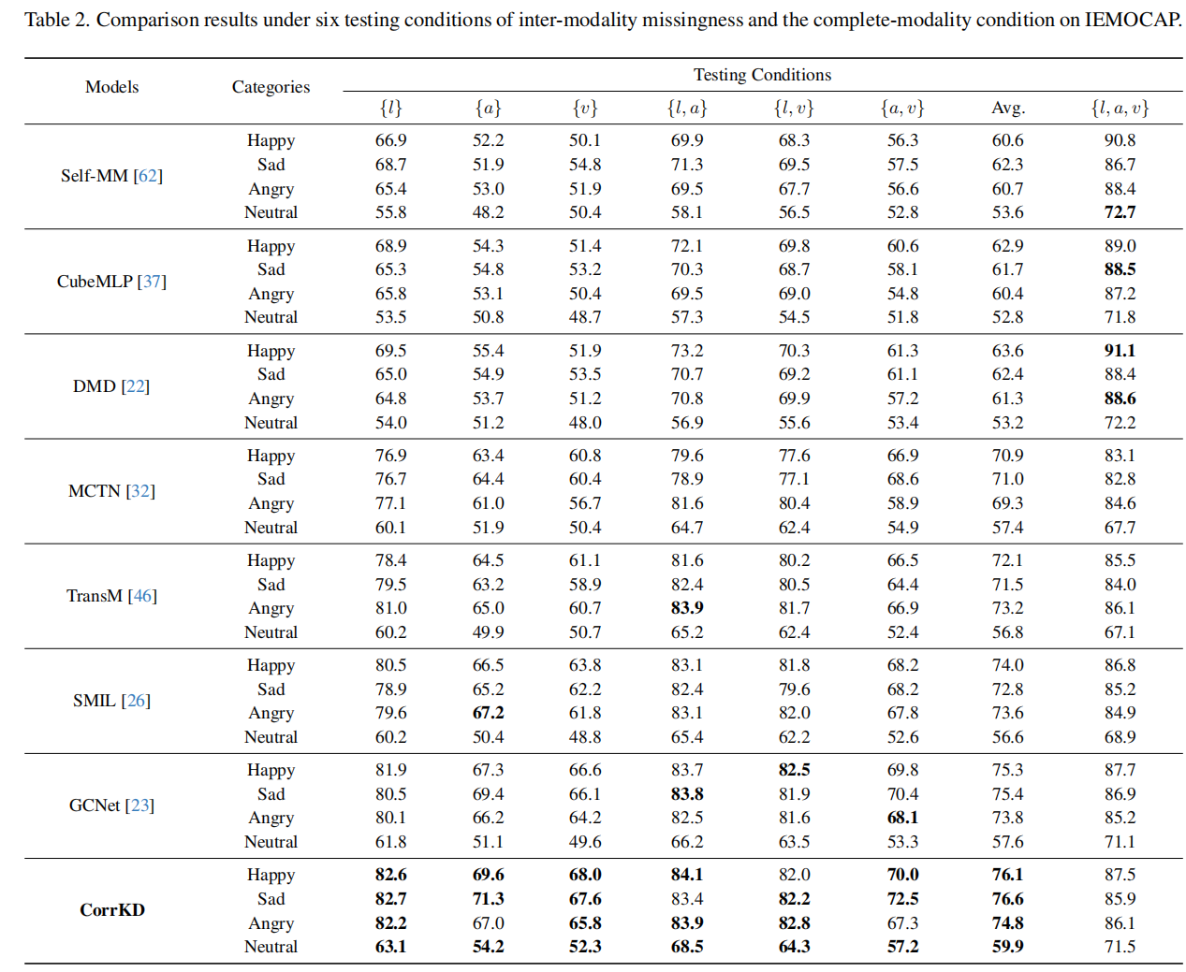
ATAI
AdvancedTechniqueof
Artificial Intelligence
ATAI
ChongqingUniversity _{AdvancedTechniqueof}
of Technology Artificial Intelligence
ChongqingUniversity of Technology
Experiments

Slide 8
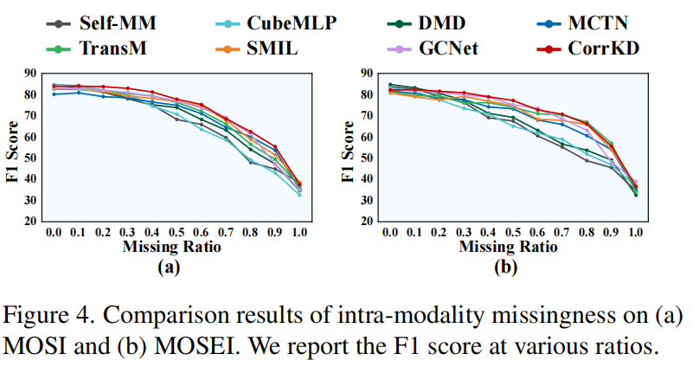
ChongqingUniversity of Technology
ATAI
AdvancedTechniqueof
Artificial Intelligence
ATAI
ChongqingUniversity _{AdvancedTechniqueof}
of Technology Artificial Intelligence
Experiments

Slide 9
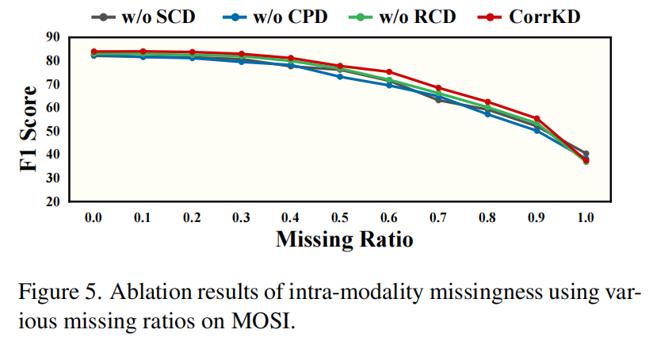
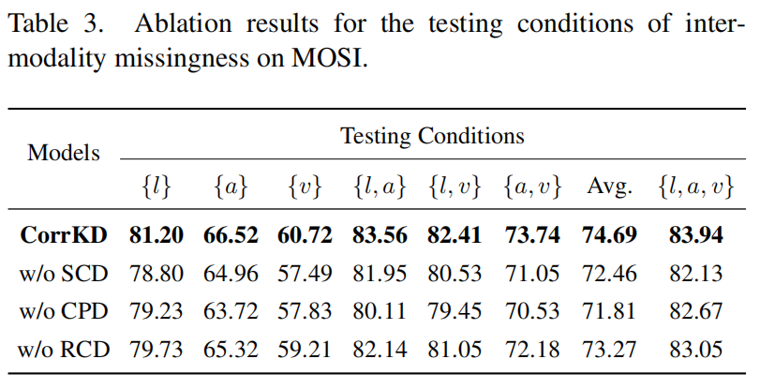
ChongqingUniversity of Technology
ATAI
AdvancedTechniqueof
Artificial Intelligence
ATAI
ChongqingUniversity _{AdvancedTechniqueof}
of Technology Artificial Intelligence
Experiments

Slide 10
ChongqingUniversity of Technology
ATAI
AdvancedTechniqueof
Artificial Intelligence
ATAI
ChongqingUniversity _{AdvancedTechniqueof}
of Technology Artificial Intelligence
Thanks!

